Slide 1
Assignment 1
Assignment 3

Slide 2
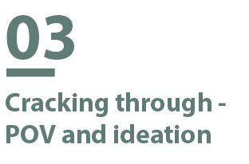
Assignment 3: Assignment 3:Cracking through - POV and ideation
Part1: POV & rationale
Each team selects one POV for your team’s final project. Please elaborate concisely and clearly: why you select this POV, how you reach its final form, and the chains of evidence to support your decision.
POV: PG TA in HKUST need a way to conveniently answer questions by UG Engineering students outside of class because there are multiple platforms students use to ask their questions outside tutorials.
Why we select this POV: We chose this POV based on one of our previous 3 POVS about PG TA answering students’ questions in different platforms, since it is directly related to our chosen topic on “Challenges of PG TA in Engineering Faculty”, has a specific and clear audience of Engineering PG TA and their UG students for consideration, raises the most resonance among TAs and Professors , and the project scope could potentially be extended to all educators in Hong Kong university once a prototype for UST PG TA is developed, thus a large impact scope.
How you reach its final form: We started from identifying different challenges faced by PG TA, then identifying that 3 most significant ones are the lack of sleeping time, too much time spent on answering questions out-of-class and long meeting hours. Among these 3, we find sleeping time to be too prevalent of an issue and could not be specified towards Engineering PG TA and students. Also, long meeting hours is a complex issue that involves many stakeholders such as supervisors, Professors in charge and course coordinators, plus we have no direct access to these meetings.
With these 2 difficulties, we are left with the issue of out-of-class questions. After analysis, we have identified that UG students asking in different platforms and preferring to ask out of tutorials are two main reasons leading to PG TA in HKUST having a hard time answering questions. Therefore, we have composed our POV on these 2 root causes and the need to answer questions with higher efficiency.
1

Slide 3
Assignment 3: Assignment 3:Cracking through - POV and ideation
Part1: POV & rationale
Each team selects one POV for your team’s final project. Please elaborate concisely and clearly: why you select this POV, how you reach its final form, and the chains of evidence to support your decision.
PG TA want to save more time on their major tasks (research) because answering students’ questions can be time-consuming.
Iteration Process
2. PG TA thinks that answering students’ questions
is time-consuming because they receive a large
number of questions by UG students outside of
class and these replies can be hard to track.
3. PG TA find these questions hard to track
because there are multiple platforms
(e.g. Outlook, WhatsApp, Telegram, Canvas,
etc.) that UG students use to ask.
1

Slide 4
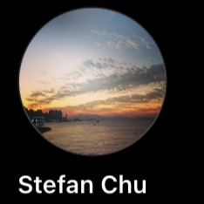
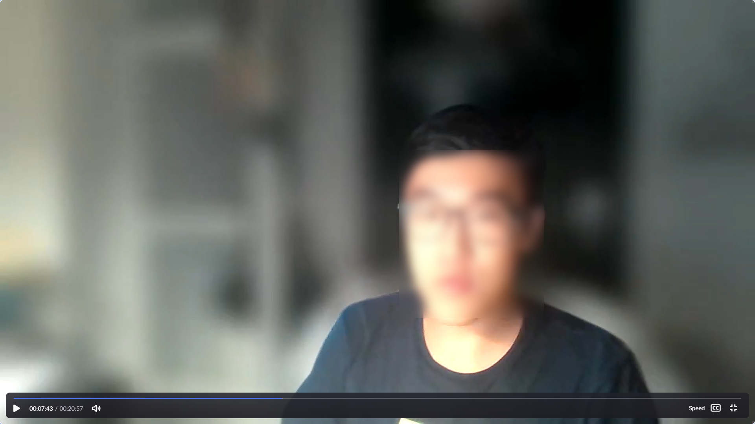
Assignment 3: Assignment 3:Cracking through - POV and ideation
Part1: POV & rationale
Each team selects one POV for your team’s final project. Please elaborate concisely and clearly: why you select this POV, how you reach its final form, and the chains of evidence to support your decision.
Evidence Chain for Step 1: PG TA want to save more time on their major tasks (research) because answering students’ questions can be time-consuming.
Evidence:
Interview with EMIA 2020 PG TA:
The TA felt that time management is an issue and some TA would prefer to save time for their research instead.
Interview with CIVL PG TA Stefan:
The TA felt that answering students is the most time-consuming task, which added heavily to his workload as PG TA. This led him to sleep deprivation.
1

Slide 5

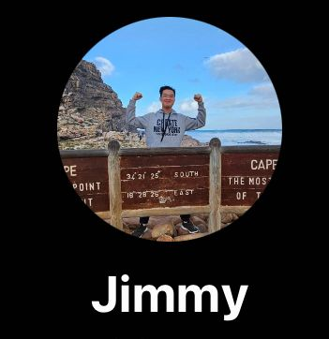
Assignment 3: Assignment 3:Cracking through - POV and ideation
Part1: POV & rationale
Each team selects one POV for your team’s final project. Please elaborate concisely and clearly: why you select this POV, how you reach its final form, and the chains of evidence to support your decision.
Evidence Chain for Step 2: PG TA thinks that answering students’ questions is time-consuming because they receive a large number of questions by UG students outside of class and these replies can be hard to track.
Evidence:
Interview with CIVL PG TA Stefan:
He found that although students don’t ask questions during class, they come with a stream of questions after or outside of class which he finds these questions hard to track.
Interview with UG Engineering students:
Both extreme and majority UG Engineering students prefer to ask questions out of tutorial sessions. They find tutorials waste of time, but value the chance to ask TA after class.
1

Slide 6
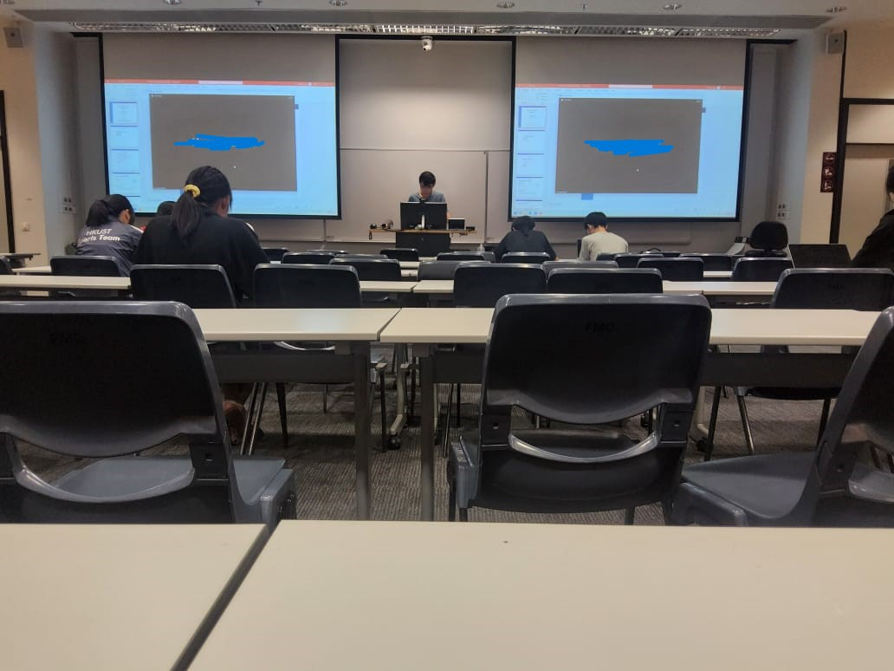
Assignment 3: Assignment 3:Cracking through - POV and ideation
Part1: POV & rationale
Each team selects one POV for your team’s final project. Please elaborate concisely and clearly: why you select this POV, how you reach its final form, and the chains of evidence to support your decision.
Evidence Chain for Step 3: PG TA find these questions hard to track because there are multiple platforms (e.g. Outlook, WhatsApp, Telegram, Canvas, etc.) that students use to ask.
Evidence:
Interview with CIVL PG TA Stefan:
He reveals that he receives questions from Outlook, Groupchat and other channels from UG students.
Interview with CIVIL PG TA Chen:
He allows students to ask him questions in Outlook, WhatsApp and WeChat. Answering these questions could be time-consuming for him.
1

Slide 7
Assignment 3: Assignment 3:Cracking through - POV and ideation
Part 2: Net of opportunity.
Use the why-chain and/or the how-chain to construct the net of opportunity for your project. Show clearly the net in this assignment. State the number of levels and nodes of the net. Put these two items in the following box: 1) the screenshot of the net; and 2) the Miro link to the net.
Based on the net, each team brainstorms solutions to address this POV. Be clear about which nodes the solutions solve by mapping the ideas to the net. Each member provides at least 10 ideas.
Part 3: Ideation
We categorized the chains of ideas into 4 parts:
How do PGTA solve this challenge?
How do UG students solve this challenge
Why do students ask questions outside of class?
Why do students use different platforms?
Miro link: Assignment Templates, Visual Workspace for Innovation (miro.com)
Level of net: max (7,6) = 7
# of nodes: 255
# of ideas: 61
2

Slide 8
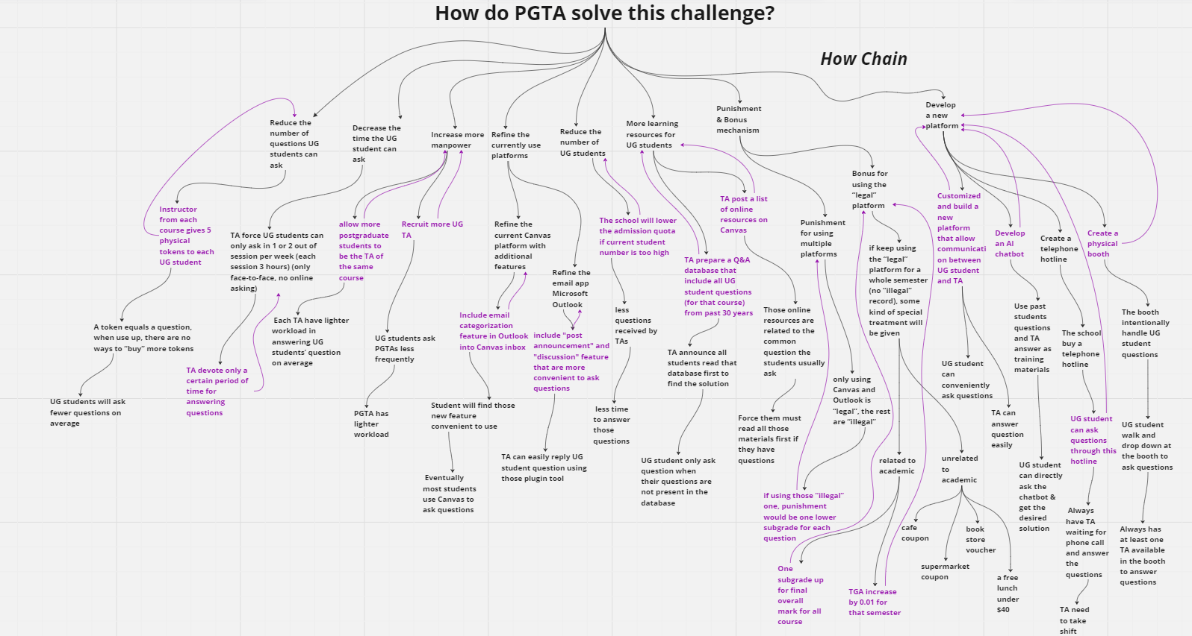
Assignment 3: Assignment 3:Cracking through - POV and ideation
Based on the net, each team brainstorms solutions to address this POV. Be clear about which nodes the solutions solve by mapping the ideas to the net. Each member provides at least 10 ideas.
Part 3: Ideation
3

Slide 10
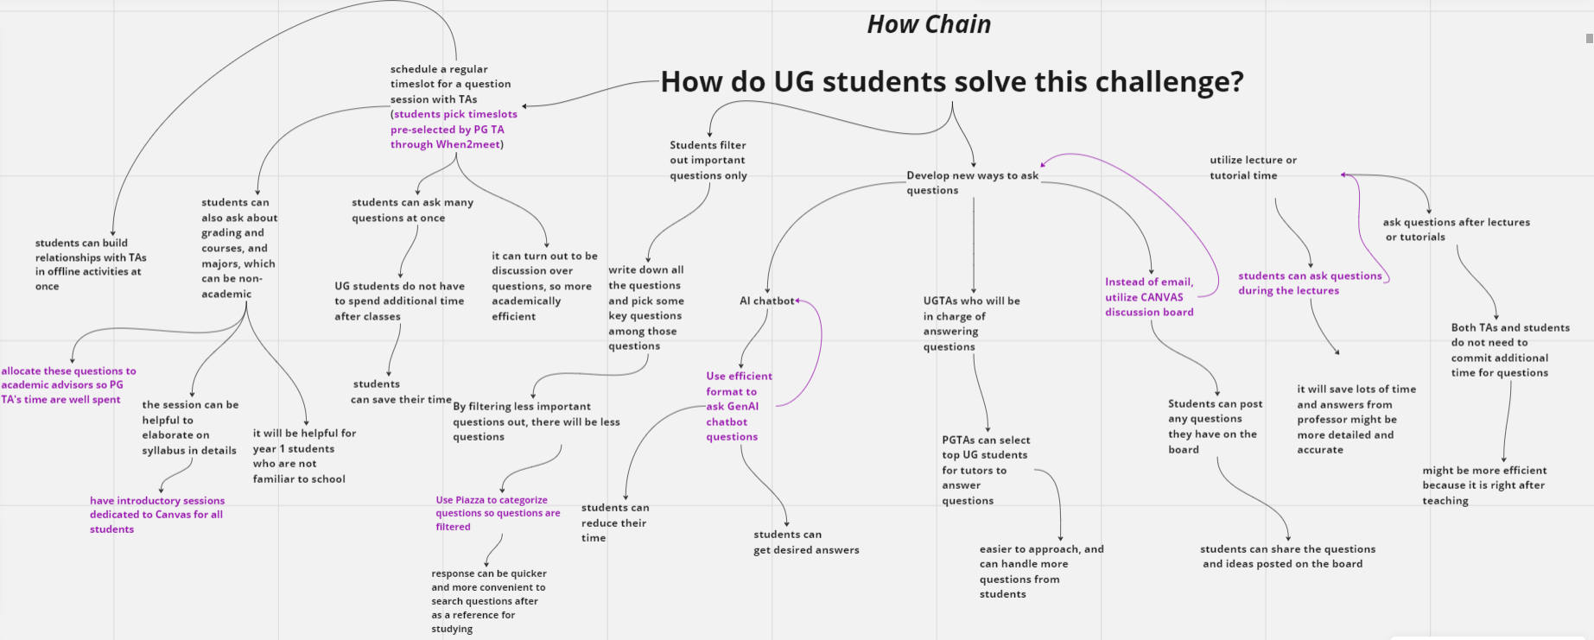

Slide 11
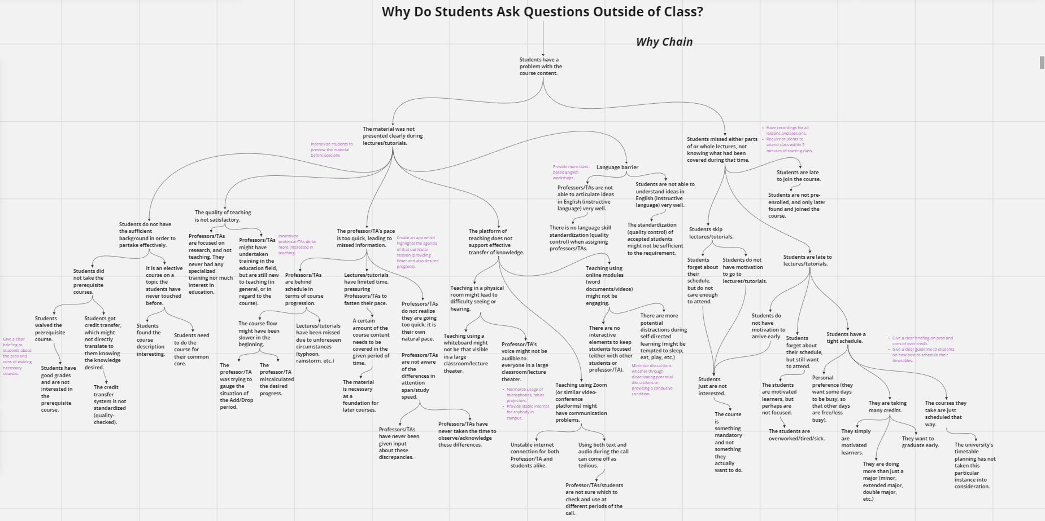

Slide 12
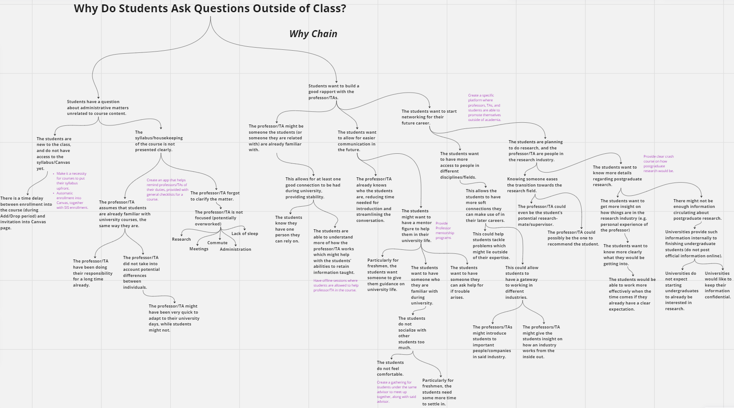

Slide 13
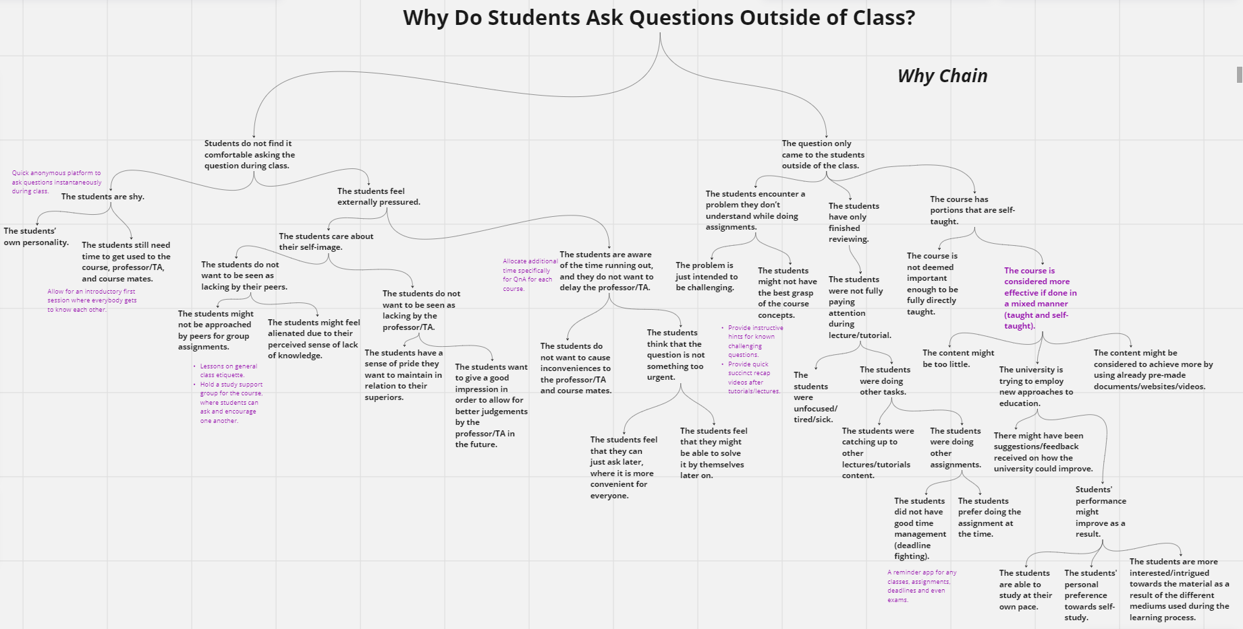

Slide 14
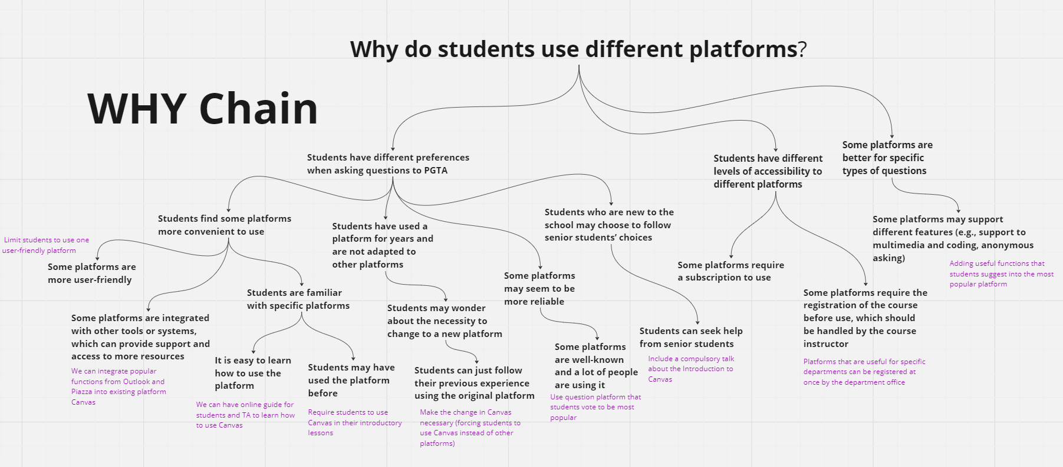

Slide 15
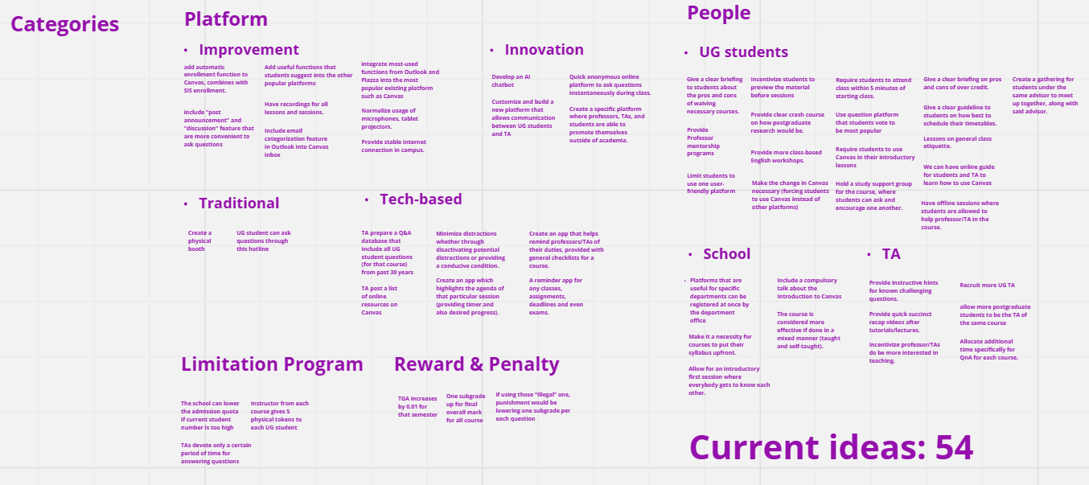

Slide 16
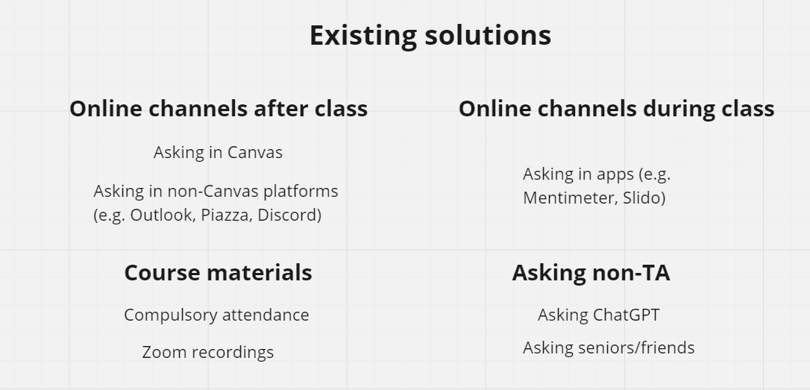
Assignment 3: Assignment 3:Cracking through - POV and ideation
Part 4: Survey & analysis
Conduct background research on existing solutions for this POV. Understand their strength and weakness. Do these solutions solve your POV? If not, why? What are missing? Please concisely summarize your findings and thoughts. This is to help you understand deeper the POV and to give you inspirations.
4

Slide 17

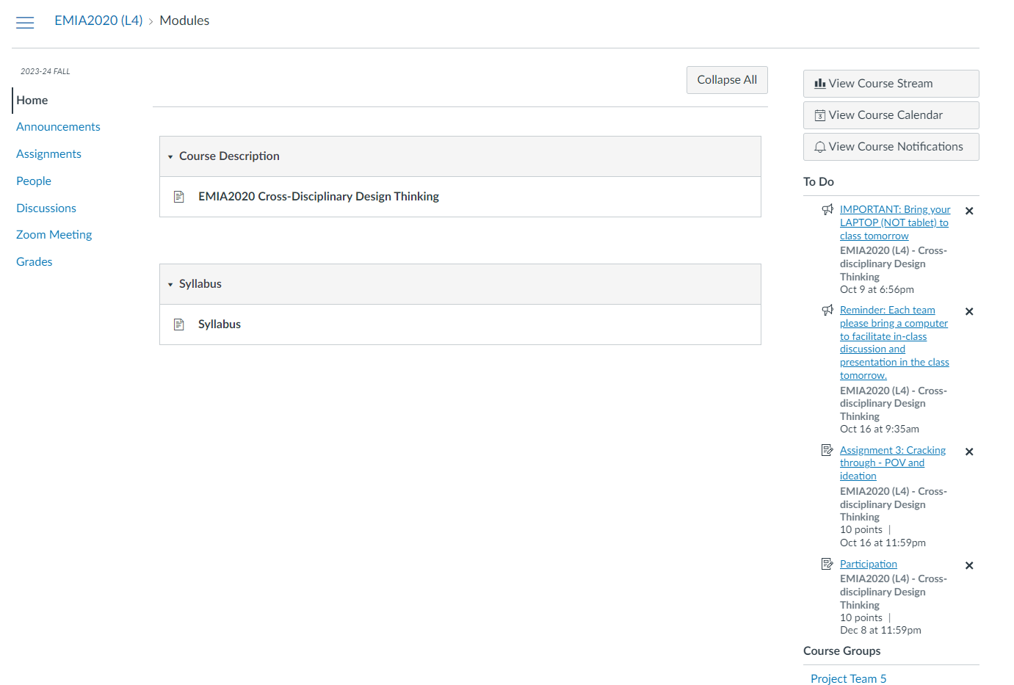
Assignment 3: Assignment 3:Cracking through - POV and ideation
Part 4: Survey & analysis
Conduct background research on existing solutions for this POV. Understand their strength and weakness. Do these solutions solve your POV? If not, why? What are missing? Please concisely summarize your findings and thoughts. This is to help you understand deeper the POV and to give you inspirations.
Canvas
Pros:
Usage by users guaranteed to be 100%
Academic-specific communication
Cons:
Low awareness (< 50% UG students knew Canvas functions, TA doesn't know functions as well)
Very low willingness to use (Almost all respondents have NOT used Canvas functions even if they knew those functions)
Missing:
There is a lack of incentive for students and TA to learn and use Canvas.
Reference: Canvas by Instructure | World's #1 Teaching and Learning Software
4

Slide 18
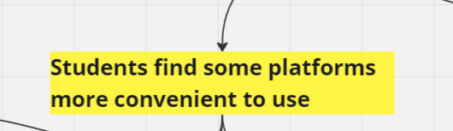



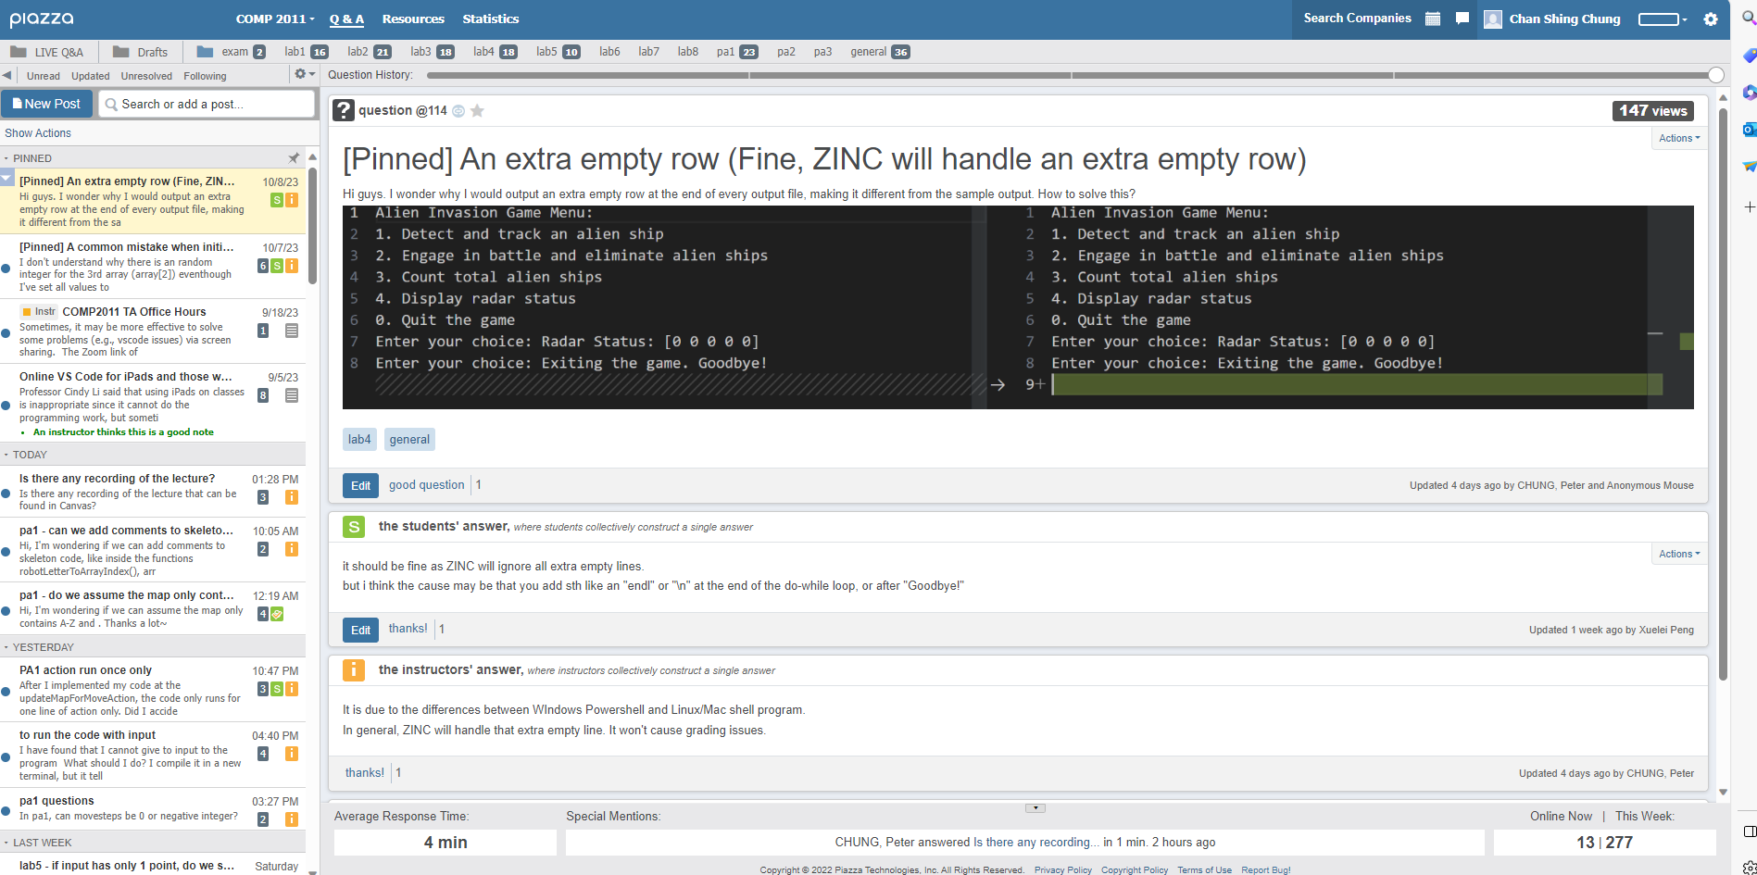
Assignment 3: Assignment 3:Cracking through - POV and ideation
Part 4: Survey & analysis
Conduct background research on existing solutions for this POV. Understand their strength and weakness. Do these solutions solve your POV? If not, why? What are missing? Please concisely summarize your findings and thoughts. This is to help you understand deeper the POV and to give you inspirations.
Other platforms (e.g. Outlook, Piazza, Discord)
Deals with:
Pros:
100% of survey respondents have used and preferred to use their familiar platform
More functions (e.g. Anonymous Discussion, sub-channels)
Cons:
Some platforms may incur expenses (e.g. USD 379/term for Piazza)
Root cause for questions in multiple platforms
Missing:
This existing solution is the very root cause of our POV.
Reference: Microsoft Outlook Personal Email and Calendar | Microsoft 365, Piazza • Ask. Answer. Explore. Whenever., Discord | Your Place to Talk and Hang Out
4

Slide 19
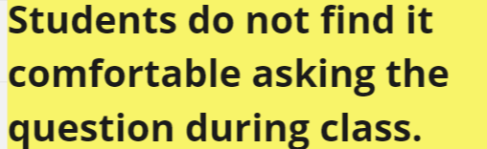
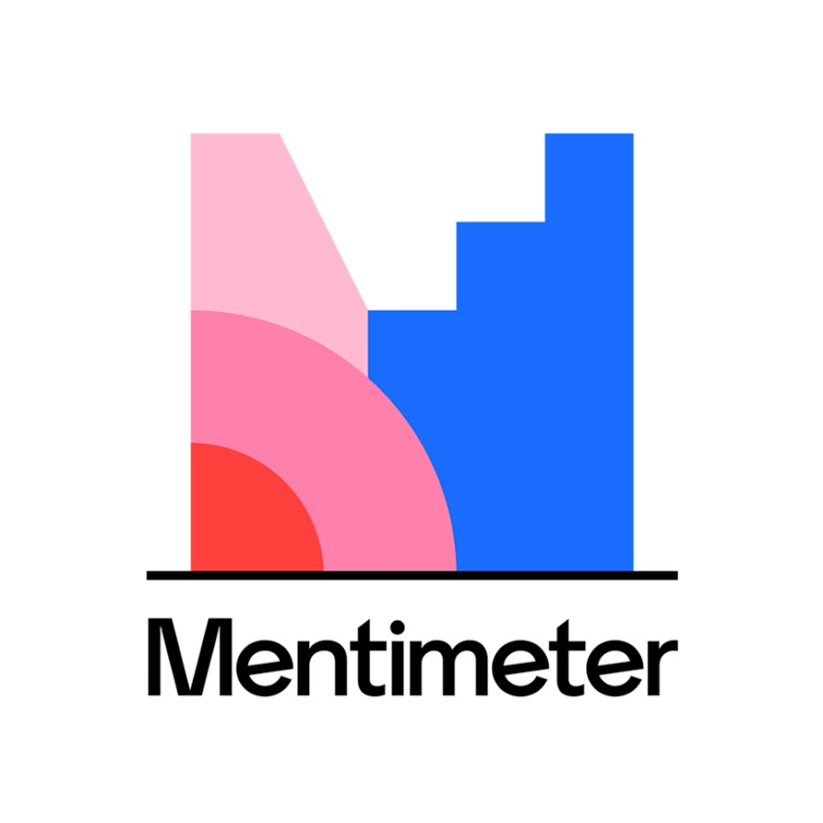

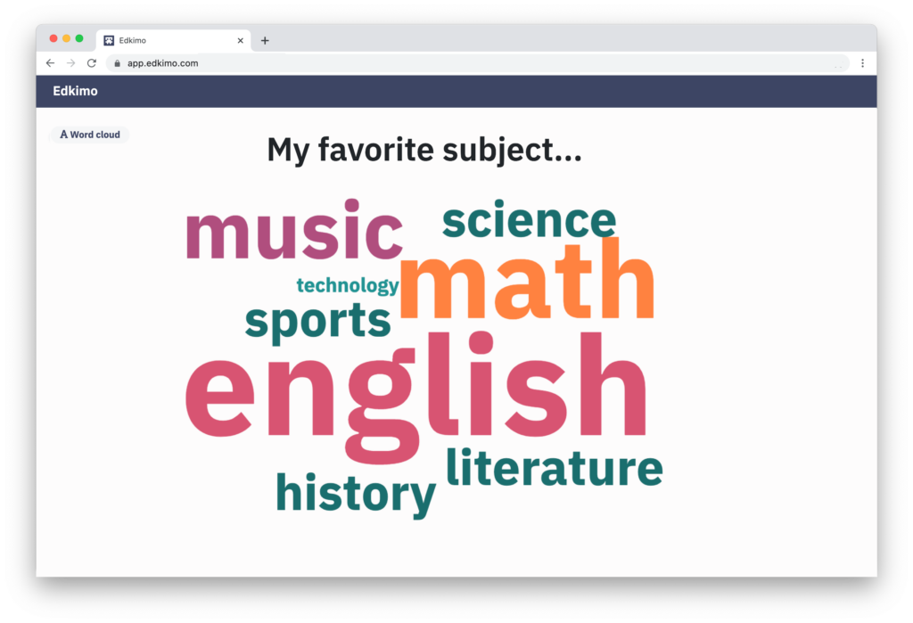
Assignment 3: Assignment 3:Cracking through - POV and ideation
Part 4: Survey & analysis
Conduct background research on existing solutions for this POV. Understand their strength and weakness. Do these solutions solve your POV? If not, why? What are missing? Please concisely summarize your findings and thoughts. This is to help you understand deeper the POV and to give you inspirations.
Online asking platforms in class (e.g. Mentimeter, Slido)
Deals with:
Pros:
Less friction for UG students to ask in class (since students have different factors for asking outside of class in Why-chain)
Less additional time needed from PG TA
Cons:
Very low student attendance rate (<25% from our field studies)
Doesn't support further conversation
Missing:
Very few students attend tutorial to begin with, so the effectiveness is limited.
Reference: Interactive presentation software - Mentimeter, Slido - Audience Interaction Made Easy
4

Slide 20
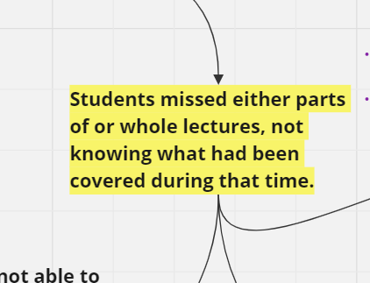

Assignment 3: Assignment 3:Cracking through - POV and ideation
Part 4: Survey & analysis
Conduct background research on existing solutions for this POV. Understand their strength and weakness. Do these solutions solve your POV? If not, why? What are missing? Please concisely summarize your findings and thoughts. This is to help you understand deeper the POV and to give you inspirations.
Compulsory attendance in class
Deals with:
Pros:
Can significantly increase attendance rate so they can ask questions in class instead (all interviewed UG agree that they will attend tutorials with attendance taken)
Cons:
Very disincentivizing (all UG students think that they won't pay attention to mandatory tutorial sessions)
Missing:
Only solves the superficial problem (low attendance rate), but doesn't solve the root problem (low question count during class)
4

Slide 21

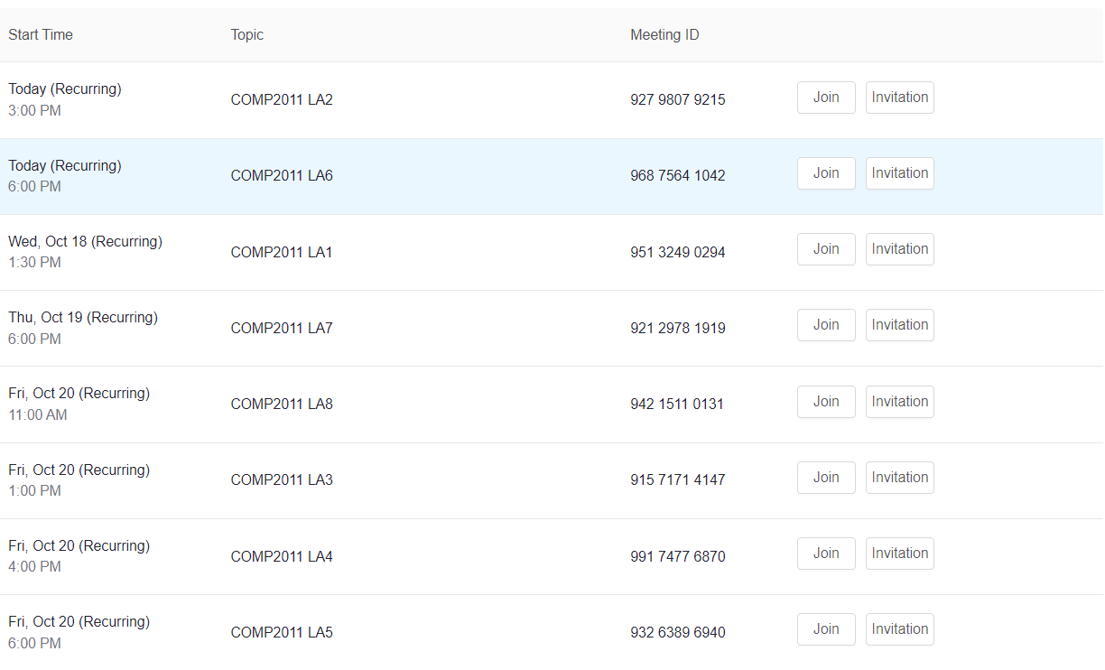
Assignment 3: Assignment 3:Cracking through - POV and ideation
Part 4: Survey & analysis
Conduct background research on existing solutions for this POV. Understand their strength and weakness. Do these solutions solve your POV? If not, why? What are missing? Please concisely summarize your findings and thoughts. This is to help you understand deeper the POV and to give you inspirations.
Watching Zoom recording
Deals with:
Pros:
Students can watch Zoom recordings before they ask questions, so less out-of-class questions
Cons:
No interviewee or respondent prefer to watch Zoom recordings
Doesn't allow further conversation
Missing:
Students still ask questions after Zoom recordings, plus they don't watch them to begin with
Reference: One platform to connect | Zoom
4

Slide 22
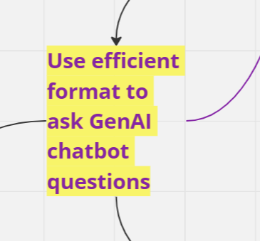

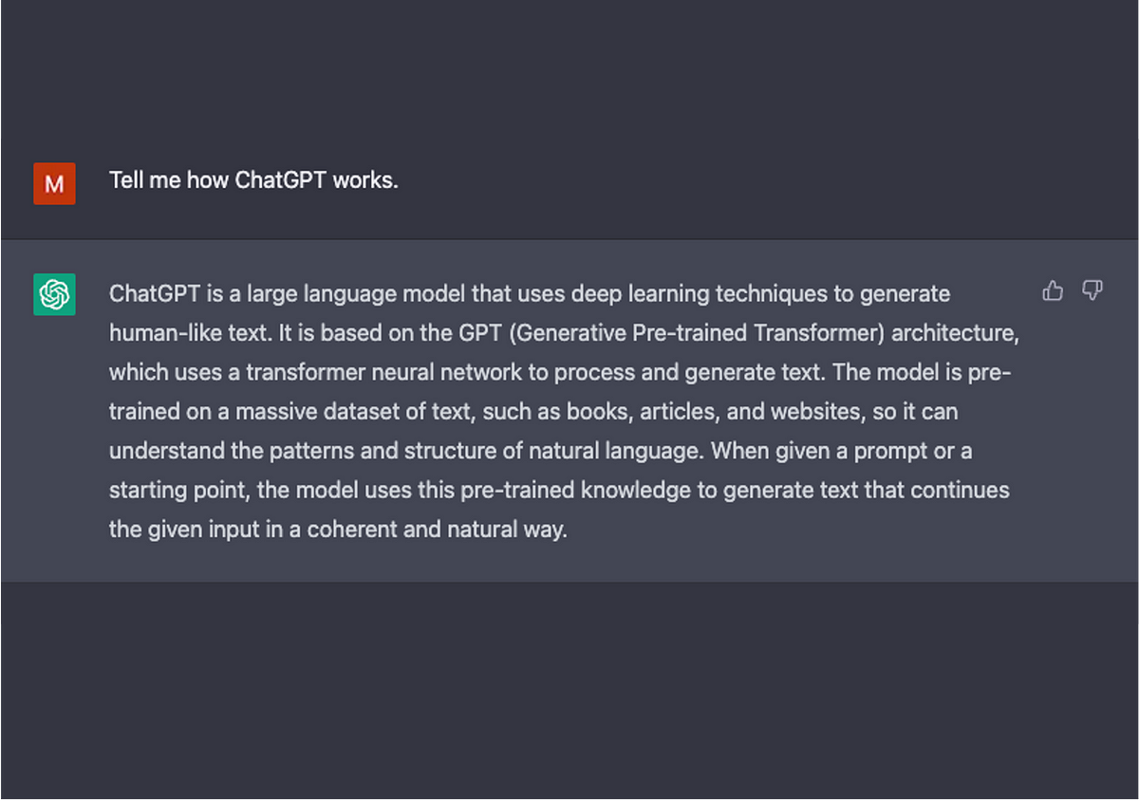
Assignment 3: Assignment 3:Cracking through - POV and ideation
Part 4: Survey & analysis
Conduct background research on existing solutions for this POV. Understand their strength and weakness. Do these solutions solve your POV? If not, why? What are missing? Please concisely summarize your findings and thoughts. This is to help you understand deeper the POV and to give you inspirations.
Asking ChatGPT
Deals with:
Pros:
Instantaneous, unlimited response to questions
All respondents preferred using ChatGPT
No need efforts from PG TA
Cons:
Does not guarantee accurate answers, as "Hallucination" effect is prevalent in ChatGPT
Missing:
Great potential, but cannot guarantee that answers are right without PG TA's supervision
Reference: chat.openai.com
4

Slide 23
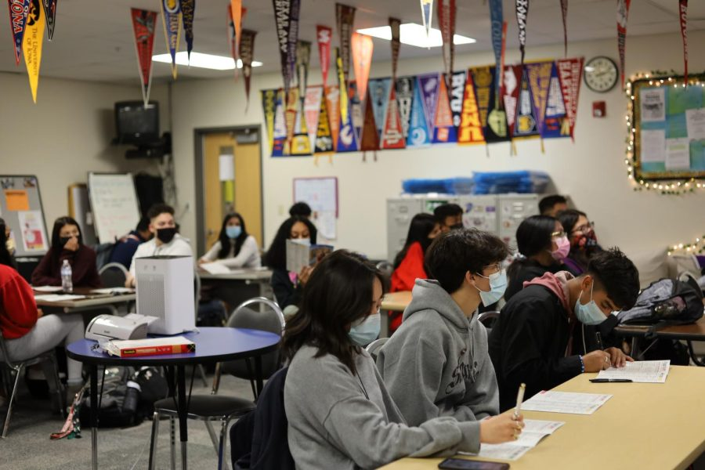
Assignment 3: Assignment 3:Cracking through - POV and ideation
Part 4: Survey & analysis
Conduct background research on existing solutions for this POV. Understand their strength and weakness. Do these solutions solve your POV? If not, why? What are missing? Please concisely summarize your findings and thoughts. This is to help you understand deeper the POV and to give you inspirations.
Asking seniors/friends
Deals with:
Pros:
No need to ask unfamiliar people, less friction for UG Engineering students
Cons:
Cannot guarantee that answers are accurate
The availability of people we ask can be limited
Missing:
Cannot guarantee that answers are right without PG TA's supervision
4

Slide 24
Assignment 3: Assignment 3:Cracking through - POV and ideation
Part 4: Survey & analysis
Conduct background research on existing solutions for this POV. Understand their strength and weakness. Do these solutions solve your POV? If not, why? What are missing? Please concisely summarize your findings and thoughts. This is to help you understand deeper the POV and to give you inspirations.
Common Gaps of Existing Solutions:
No incentives to use one single online questioning platform out-of-class
Low attendance and attention render in-class solutions ineffective
Solutions based on course materials do not provide room for further communication
Asking people apart from PG TA could receive inaccurate answers
Therefore, we need to incentivize UG Engineering students to use one single online questioning platform with participation of multiple stakeholders including PG TA.
4

Slide 25
Assignment 3: Assignment 3:Cracking through - POV and ideation
Part 4: Survey & analysis
Conduct background research on existing solutions for this POV. Understand their strength and weakness. Do these solutions solve your POV? If not, why? What are missing? Please concisely summarize your findings and thoughts. This is to help you understand deeper the POV and to give you inspirations.
Candidate Ideas:
With the common gaps in mind, we think that these three ideas can bridge the gap between users' needs and existing solutions.
1. Promoting use of Canvas (Canvas session/Canvas guide/rewarding scheme)
2. Developing one new centralized platform
3. Incorporating ChatGPT with PG TA answering
4

Slide 26
Assignment 3: Assignment 3:Cracking through - POV and ideation
Part 4: Survey & analysis
Conduct background research on existing solutions for this POV. Understand their strength and weakness. Do these solutions solve your POV? If not, why? What are missing? Please concisely summarize your findings and thoughts. This is to help you understand deeper the POV and to give you inspirations.
Promoting use of Canvas (Canvas session/Canvas guide/rewarding scheme)
Canvas has great usage percentage and functionality, but PG TA and UG students are not utilizing this one-in-all platform because they are not familiar with it and have no incentives to learn how to use it.
Therefore, once we can bridge the gap in awareness and willingness for Canvas, we can see that most students will tend to ask in Canvas.
Also, since we realize that TA could potentially be unfamiliar with Canvas functions as well, this promotion can assist PG TA to be more efficient as they answer with Canvas.
Centralizing UG Engineering questions into Canvas with higher efficiency is a promising way to solve our POV.
4

Slide 27
Assignment 3: Assignment 3:Cracking through - POV and ideation
Part 4: Survey & analysis
Conduct background research on existing solutions for this POV. Understand their strength and weakness. Do these solutions solve your POV? If not, why? What are missing? Please concisely summarize your findings and thoughts. This is to help you understand deeper the POV and to give you inspirations.
Nodes that can be resolved by this idea:
Students have used a platform for years and are not adapted to other platforms
Students may wonder about the necessity to change to a new platform
students and TAs may not be familiar with functions on Canvas
Students may need online guide to learn how to use Canvas
Students use other platforms other than Canvas with specific use
Refine Canvas by adding useful features so that more students and TAs can use Canvas
So, the idea is based on the following categories:
Improvement
Tech-Based
4

Slide 28
Assignment 3: Assignment 3:Cracking through - POV and ideation
Part 4: Survey & analysis
Conduct background research on existing solutions for this POV. Understand their strength and weakness. Do these solutions solve your POV? If not, why? What are missing? Please concisely summarize your findings and thoughts. This is to help you understand deeper the POV and to give you inspirations.
How this idea tackle the problems of existing solution:​
This can prevent people encounter many difficulties when switching to a completely new or unfamiliar platform(s)
UG students no longer need to worry about the consideration of whether they should switch to a new platform anymore
A higher awareness for UG students and TAs to use Canvas as their major learning and education platform, thus increasing the utilization rate of Canvas
The built-in functions inside Canvas can be widely known by more UG students and TAs, such that students can better use those functions more frequently to communicate with TAs
4

Slide 29
Assignment 3: Assignment 3:Cracking through - POV and ideation
Part 4: Survey & analysis
Conduct background research on existing solutions for this POV. Understand their strength and weakness. Do these solutions solve your POV? If not, why? What are missing? Please concisely summarize your findings and thoughts. This is to help you understand deeper the POV and to give you inspirations.
2. Developing a new centralized platform
Each platform (Outlook, Piazza, Discord, etc.) has their own advantages, but also with their weaknesses. However, when used simultaneously, these differences could make it very disorienting to navigate through all the possible questions and answers.
Different students and TAs have different preferences, and as such, many people are not the most willing to compromise for the other party. This results in lack of effective communication.
There is not enough time for anyone to check through all of these platforms at the same time.
Incentivizing the usage of only one platform (based on professor's preference) could streamline and make much more efficient the process of asking questions. This is because there is clarity on how students and TAs should proceed (no confusion).
4

Slide 30
Assignment 3: Assignment 3:Cracking through - POV and ideation
Part 4: Survey & analysis
Conduct background research on existing solutions for this POV. Understand their strength and weakness. Do these solutions solve your POV? If not, why? What are missing? Please concisely summarize your findings and thoughts. This is to help you understand deeper the POV and to give you inspirations.
Nodes that can be resolved by this idea:
Some platforms are better for specific types of questions
Some platforms may support different features (e.g., support to multimedia and coding, anonymous asking)
Students have different levels of accessibility to different platforms
Some platforms require the registration of the course before use, which should be handled by the course instructor
Some platforms require a subscription to use
Some platforms may seem to be more reliable
Students have used a platform for years and are not adapted to other platforms
Students find some platforms more convenient to use
Students may wonder about the necessity to change to a new platform
… and much more nodes that can be solved by this idea (not listed here due to too many of them)
So, the idea is based on the following categories:
Platform Improvement
Platform Innovation
Tech-Based
4

Slide 31
Assignment 3: Assignment 3:Cracking through - POV and ideation
Part 4: Survey & analysis
Conduct background research on existing solutions for this POV. Understand their strength and weakness. Do these solutions solve your POV? If not, why? What are missing? Please concisely summarize your findings and thoughts. This is to help you understand deeper the POV and to give you inspirations.
How this idea tackle the problems of existing solution:
Since it is a new platform, it would not have a preconceived notion to people of being only usable for one thing (Canvas: only known/used by many as the platform to check for material, homework and grades).
It is free to use and does not have any perks hidden behind a paywall/subscription (Piazza, Discord, etc.)
It allows for greater discussion to be held: not only one-time done, and can be more than just one-on-one to have faster response and greater number of inputs, collective learning (Answering platforms, like Slido, do not allow for further conversation)
It uses familiar features from these different platforms, making it an easier transition for the different users.
Our centralized platform can also:
Give a complete using tutorial for first-time usage, adding to its goal of being accessible.
Come with a pdf usage tutorial, allowing student to learn how to use the platform if they forget how to use anything
Our platform is completely free for HKUST students and teaching staff (reducing reluctance to use)
"Further conversation" feature is enabled for student to ask any further questions to TA or professors at the quickest speed
4

Slide 32
Assignment 3: Assignment 3:Cracking through - POV and ideation
Part 4: Survey & analysis
Conduct background research on existing solutions for this POV. Understand their strength and weakness. Do these solutions solve your POV? If not, why? What are missing? Please concisely summarize your findings and thoughts. This is to help you understand deeper the POV and to give you inspirations.
3. Incorporating ChatGPT with PG TA answering
ChatGPT is much preferred by students due to its instantaneous nature, and as a result, would more likely lead to higher usage rate if it was standardized as the main platform of questioning.
This is the most beneficial approach for PG TA because it would lower their workload quite drastically (thinking time).
The problem of potential wrong answers could perhaps be tackled by having PG TA reading the questions first and then writing short bullet points of the answer which are to be given as prompts to ChatGPT. ChatGPT elaborates on these prompts, and once verified, the PG TA can send this answer back to students with faster efficiency.
To ensure that TAs could immediately answer and verify these conversations, reducing risk of misinformation, this ChatGPT service could be limited to particular sessions throughout the week (replacing help desk time).
This somewhat assistant-like usage of ChatGPT for PG TA might be a worthwhile consideration for a solution to this POV.
4

Slide 33
Assignment 3: Assignment 3:Cracking through - POV and ideation
Part 4: Survey & analysis
Conduct background research on existing solutions for this POV. Understand their strength and weakness. Do these solutions solve your POV? If not, why? What are missing? Please concisely summarize your findings and thoughts. This is to help you understand deeper the POV and to give you inspirations.
Nodes that can be resolved by this idea:
AI chatbot
Use efficient format to ask GenAI chatbot questions
Students can reduce their time
Students can get desired answers
Students can ask many questions at once
Ask questions after lectures or tutorials
Both TA and students do not need to commit additional time for questions
No language barrier
Students do not find it comfortable asking the question during class
… and much more nodes that can be solved by this idea (not listed here due to too many nodes)
So, the idea is based on the following categories:
TA-related
Tech-Based
4

Slide 34
Assignment 3: Assignment 3:Cracking through - POV and ideation
Part 4: Survey & analysis
Conduct background research on existing solutions for this POV. Understand their strength and weakness. Do these solutions solve your POV? If not, why? What are missing? Please concisely summarize your findings and thoughts. This is to help you understand deeper the POV and to give you inspirations.
How this idea tackle the problems of existing solution:
It is still allowing for students to use their preferred platforms (not disincentivizing students; reduced quality of study), but still reduces the workload and time spent by PG TA.
It allows for further discussion to still be had between students and PG TA, since they are still communicating with one another, but once again time lost is reduced.
It prevents any misinformation that might arise from students solely using ChatGPT, since the PG TA would still be verifying the answers first.
No incurred expenses on student and PG TA part.
Both the ChatGPT and limited sessions of questioning reduce the mental toll on PG TA and let them have more time available to focus on their other responsibilities/pursuits.
4

